Slide 1
Art Gallery System

Slide 2
Group 15
Group Members
Prabhnoor Saini – 100946515
Saayjon Ranjan- 100932779
Richard Edom 100927810
Ebubechukwu Agwagah - 100937022

Slide 3
Project Purpose
The goal of our team is to create an Art gallery system which is visually appealing and as well as properly working. Our website helps viewers explore various popular artists and their artworks. Moreover, new artists or art enthusiasts can upload their art and explore each other’s work.

Slide 4


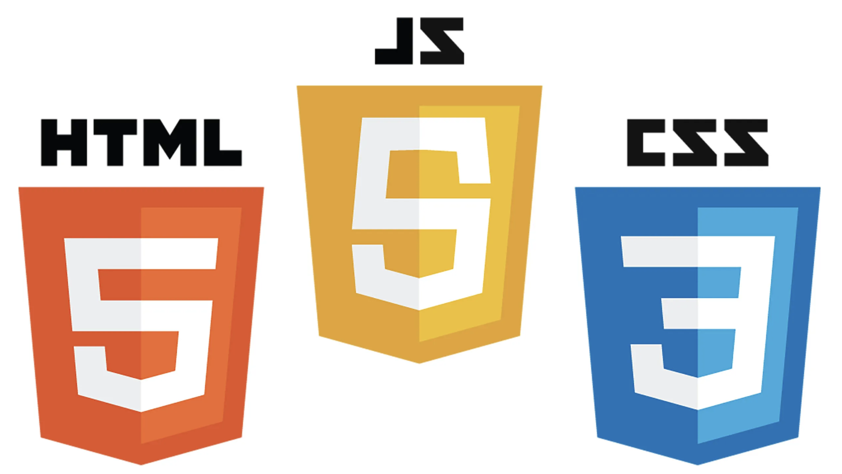





Resources used
For Version control and ease of access
Database for entered data
Programming languages
IDE's

Slide 5
Development
Planning and Design:
We began by conceptualizing the platform’s core features: uploading, exploring, and managing artworks. The design was tailored for simplicity and user-friendliness, using wireframes and a gray theme to evoke creativity and elegance.
Database Setup:
We structured the MySQL database to store essential details such as artist's first and last names, and uploaded images as file paths. Proper indexing and constraints were implemented to maintain data integrity and optimize performance.
Frontend Development:
Using HTML and CSS, we built the visual elements of the platform. CSS Grid and Flexbox were extensively utilized to create a responsive and uniform layout for showcasing artworks.
Dynamic JavaScript elements, such as interactive forms and navigation bar effects, were integrated to enhance user experience.

Slide 6
Backend Development:
The backend was developed in PHP to handle form submissions, file uploads, and database interactions. Security measures, like prepared statements, were implemented to prevent SQL injection and ensure safe file handling.
Testing and Debugging:
Regular testing was performed at each stage to identify and resolve bugs, especially with file uploads and database queries. Tools like PHP error logs were instrumental in troubleshooting.
Final Integration:
After completing individual modules, we integrated the components, ensuring smooth interaction between the frontend and backend. This involved syncing data flow, testing responsiveness, and refining the overall user interface.
Finally, the project was completed, optimizing image assets and ensuring the server environment could handle database operations and file storage.

Slide 7
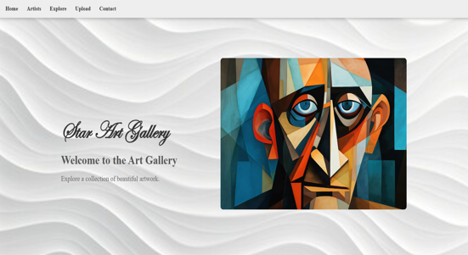
Home Page

Slide 8
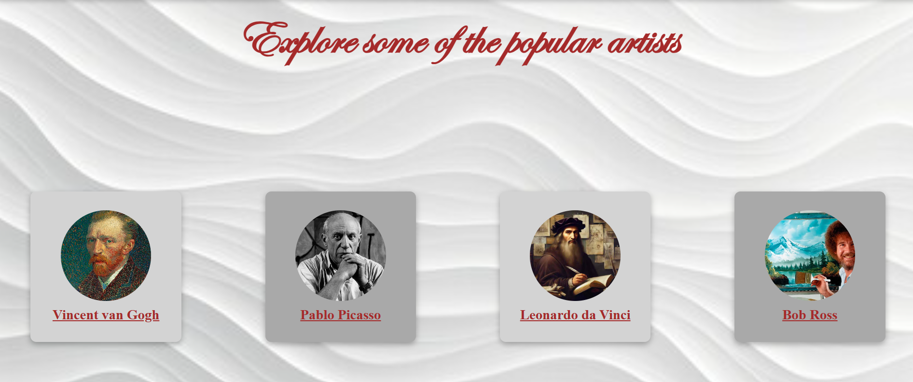
Artist Page

Slide 9
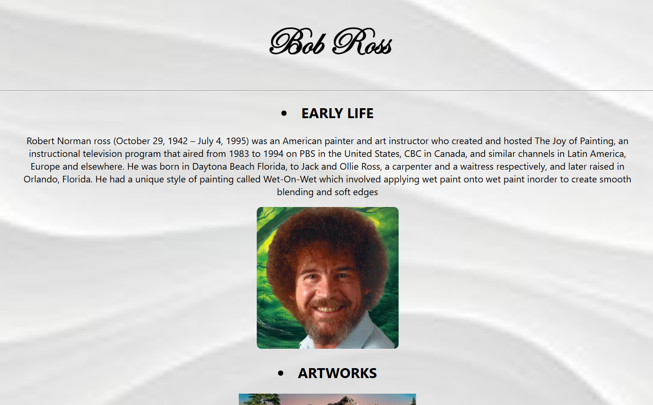
Popular Artists

Slide 10
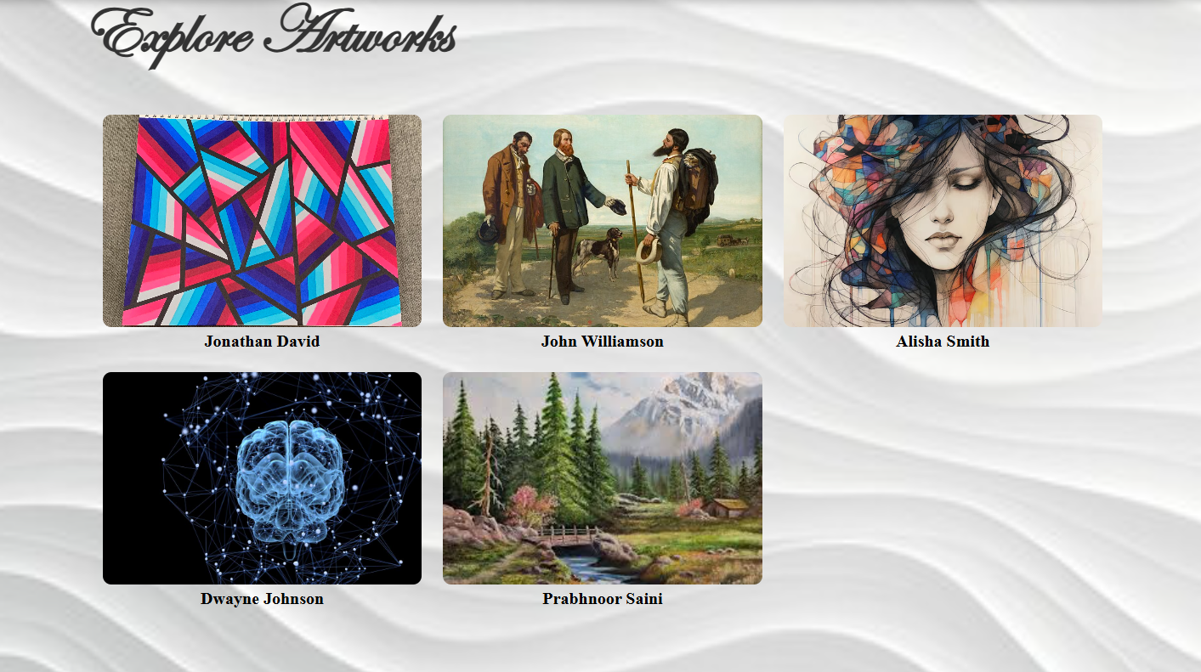
Explore Page

Slide 11
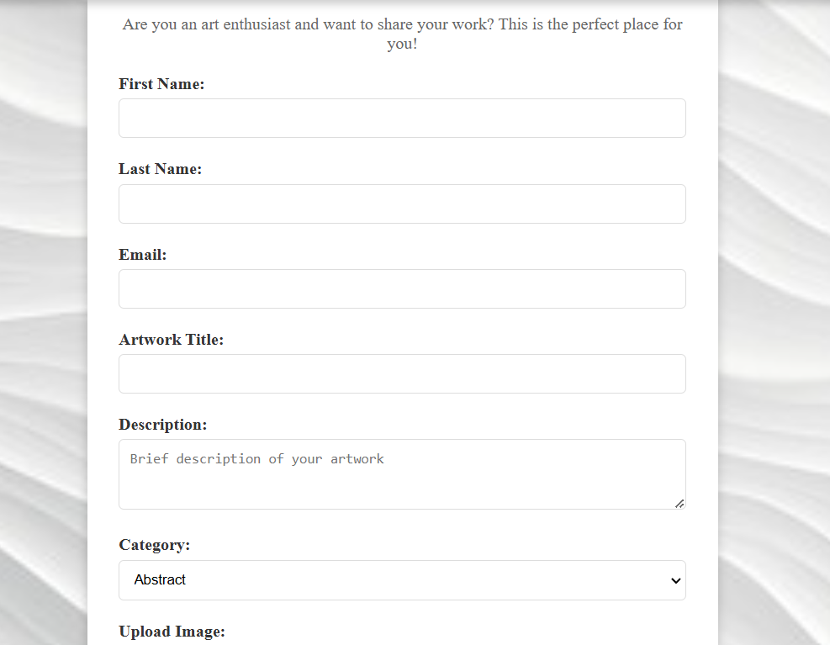
Upload feature

Slide 12
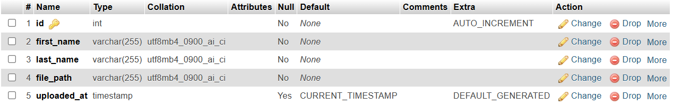
MySQL Table

Slide 13
Future Plans
As our website is still in the beginning phase, and could use some necessary improvements we have some future plans that we are implementing in the possible future.
These include:
Adding more content: Our website only contains few popular artists of our choosing and a very brief background of a couple of their artworks. We plan on adding more background to these artists and exploring more artists as well.
Language Translation: We plan on allowing users select languages of their choice by creating a drop down menu of languages and using an event listener with html to detect which language the user chooses and creating a JSON file with translations for all the text on the page. When a language is selected, the page’s text is updated using JavaScript.
Also ensuring the website is optimized for mobile devices thereby making sure all artwork is displayed well across all screen sizes and preserving image quality.

Slide 14
Thank you, Let’s move to the demo now.

